Slide 1
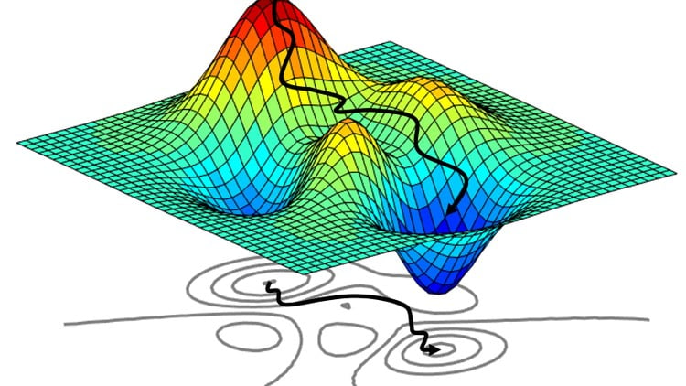
Tutorial 12
﻿CS5486 Intelligent Systems:
Intelligent Optimization Methods
Hongzong Li
Department of Computer Science City University of Hong Kong

Slide 2
Intelligent Optimization
Intelligent optimization refers to a class of optimization algorithms inspired by biological, cognitive, and physical systems. Unlike traditional mathematical programming techniques (like gradient descent or simplex), intelligent optimization methods are often heuristic or metaheuristic.
Capable of handling
Non-differentiable, non-convex, and multi-modal functions
High-dimensional or combinatorial search spaces
Dynamic and noisy environments

Slide 3

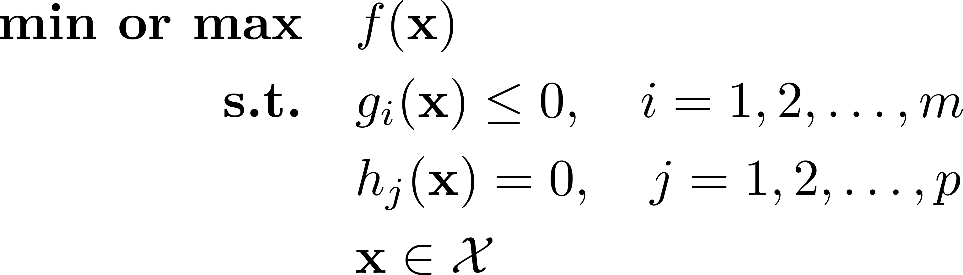
Optimization Problems
Optimization is very important for decision-makers to make good decisions before taking actions.
In general, to find the best solution of an optimization problem, we first need to construct a mathematical model to describe the problem. Normally, modelling an optimization problem needs to identify three components, which are objectives, variables, and constraints. They can be formulated as:

Slide 4
Optimization Problems
According to the type of input
Continuous Optimization: the variables used in the objective function are continuous variables
Discrete Optimization: integer values or binary values

Slide 5
Evolutionary Algorithms - GA
Genetic Algorithm
Genetic Algorithm (GA) is a bio-inspired metaheuristic optimization method based on the principles of natural selection and genetic evolution.
1. Initialize population P with N random individuals
2. Evaluate the fitness f(x) of each individual in P
3. Repeat until stopping criterion is met:
a. Select parents from P using a selection strategy
b. Apply crossover to selected parents to produce offspring
c. Apply mutation to the offspring with some probability
d. Evaluate the fitness of the new offspring
e. Form a new population P by selecting from parents and offspring (replacement)
4. Return the best individual found

Slide 6
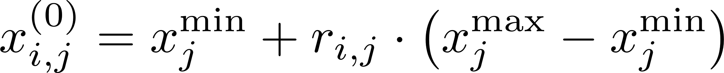
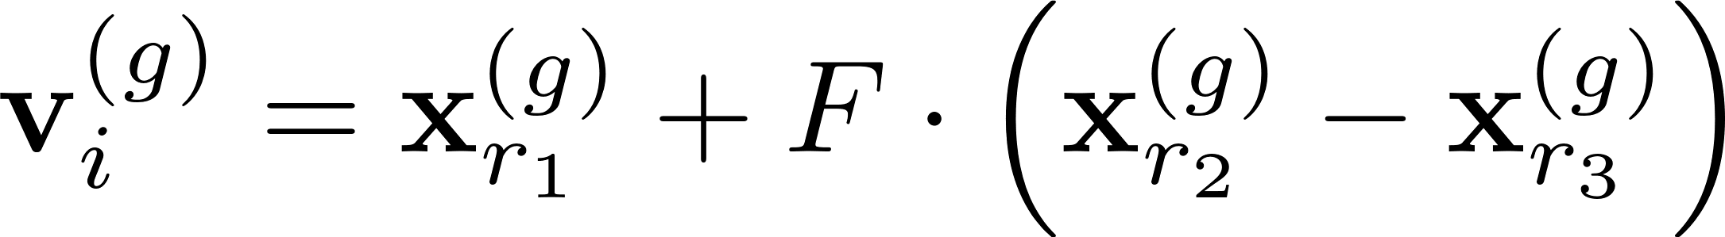
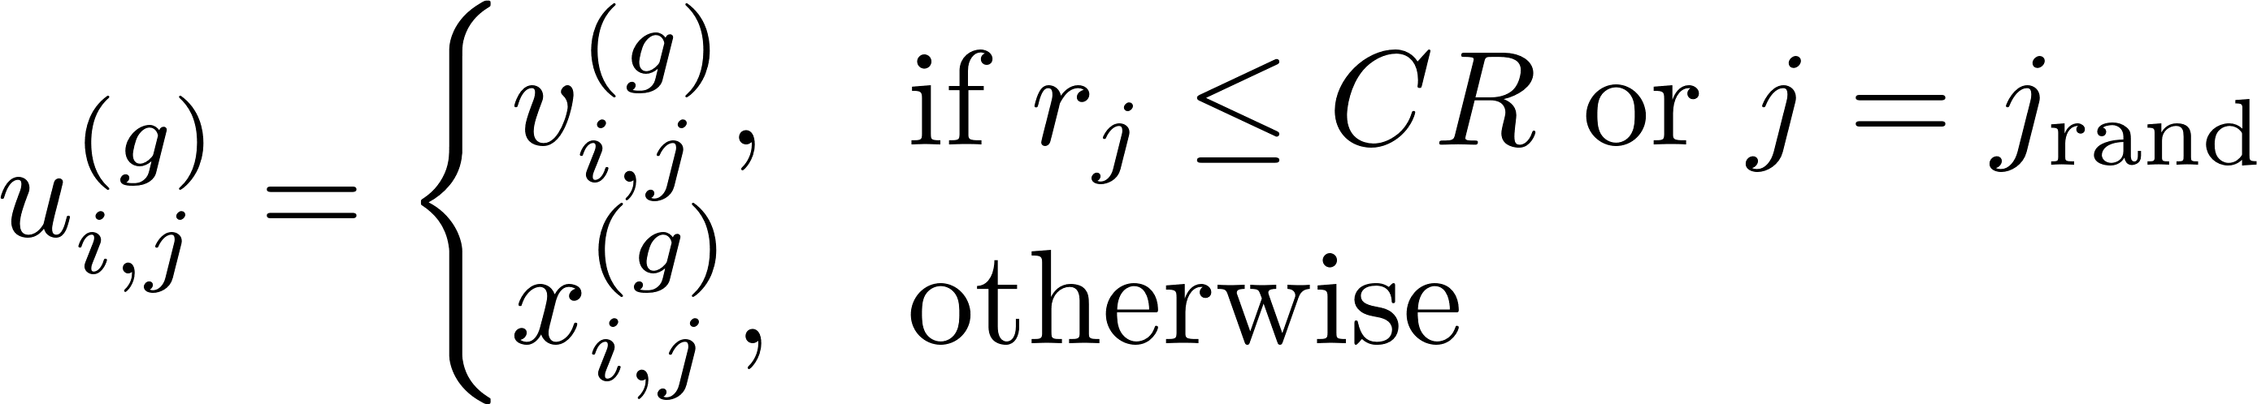
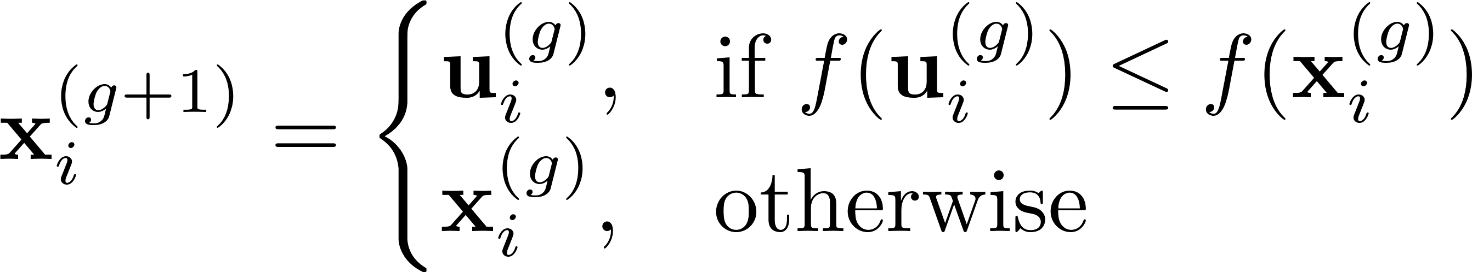
Evolutionary Algorithms - DE
Differential Evolution
Differential Evolution (DE) is an evolutionary optimization algorithm designed for continuous search spaces. It evolves a population of candidate solutions over time using mutation, crossover, and selection, but its key innovation lies in how mutation is performed — via differencing individuals from the population.
Initialization
Mutation
Crossover:
Selection:
v: mutant vector
CR: crossover rate

Slide 7



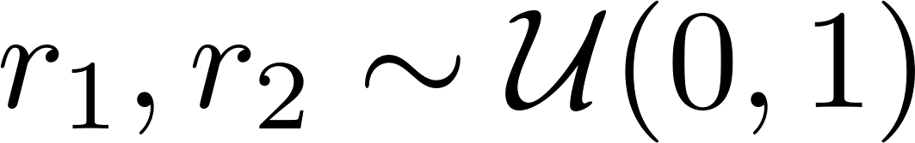
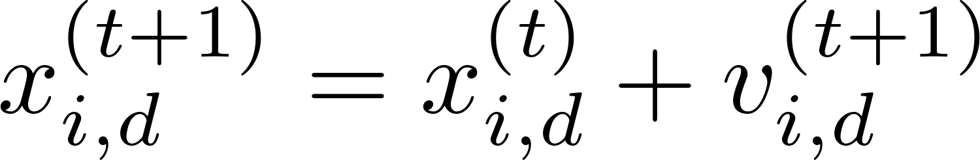
Swarm Intelligence Algorithms - PSO
Particle Swarm Optimization
inspired by the social behavior of birds flocking or fish schooling, proposed by Kennedy and Eberhart in 1995.
1. Velocity Update
inertia weight (balance exploration/exploitation)
cognitive coefficient (self confidence)
social coefficient (swarm confidence)
random values
2. Position Update

Slide 8
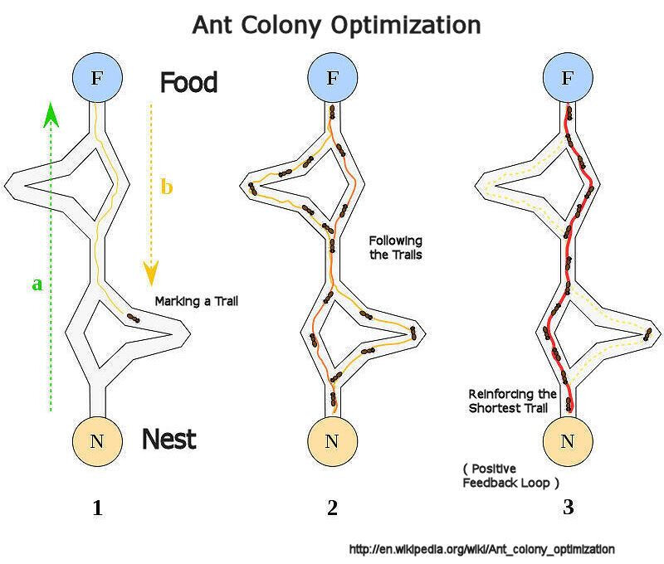
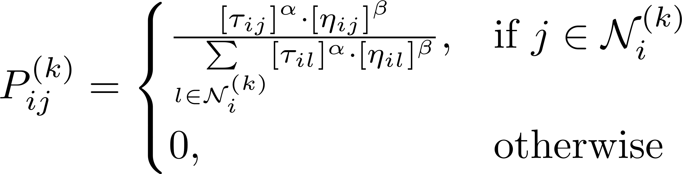
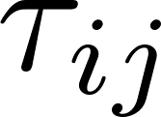
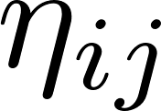
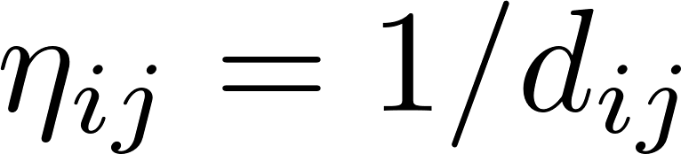


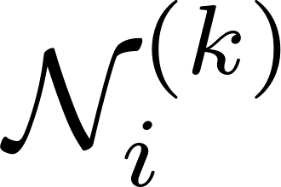
Swarm Intelligence Algorithms - ACO
Ant Colony Optimization
inspired by the foraging behavior of real ants, particularly how they find shortest paths using pheromone trails.
1. Solution Construction
transition probability to go from node i to node j
: pheromone level on edge (i, j)
: heuristic desirability
: controls influence of pheromone
: controls influence of heuristic
: unvisited nodes for ant k

Slide 9
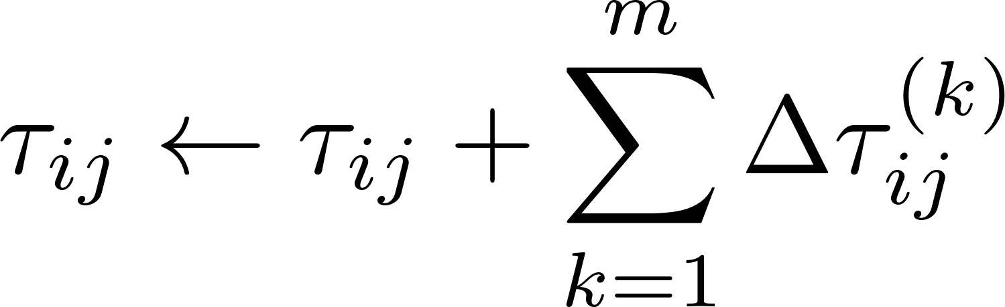
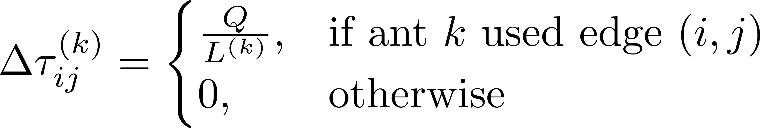
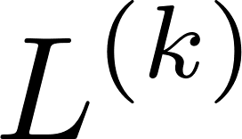
Swarm Intelligence Algorithms - ACO
Ant Colony Optimization
2. Pheromone Update
a. Pheromone Evaporation
b. Pheromone Reinforcement
Q : constant
: cost of solution constructed by ant \( k \)

Slide 10
Genetic Algorithms vs. Particle Swarm Optimization
 | Genetic Algorithm (GA) | Particle Swarm Optimization (PSO)
Inspiration | Natural evolution & genetics | Bird flocking and fish schooling
Search Operators | Crossover and mutation | Velocity and position updates
Information Sharing | Through recombination (crossover) | Through global best and neighborhood best
Key Parameters | Population size, crossover rate, mutation rate | Swarm size, inertia weight, cognitive/social coefficients

Slide 11
Which of the following is not a key operator in a Genetic Algorithm (GA)?
Crossover
B. Mutation
C. Velocity Update
D. Selection

Slide 12
In Particle Swarm Optimization (PSO), the position of a particle is updated based on:
Global best position only
Random walk
Its own best position and the global best position
Mutation and crossover

Slide 13
In Differential Evolution (DE), new candidate solutions are generated by:
Crossover of the best two individuals
Adding weighted differences between population vectors
Mutating one individual randomly
Updating velocities and positions

Slide 14
In Ant Colony Optimization (ACO), what drives the search process over time?
Genetic diversity
Adaptive learning rate
Pheromone evaporation and reinforcement
Step-size adaptation

Slide 15
Thanks

